Slide 1
Drone jatti ne..

Slide 2
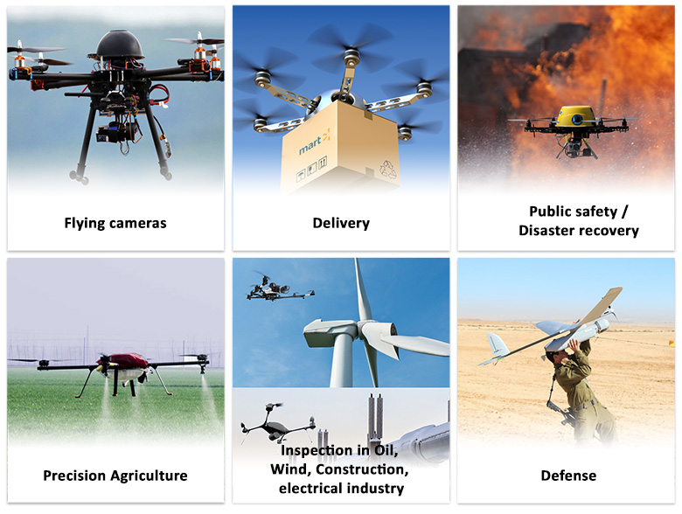
What is a Drone?
A drone is an unmanned aircraft. Drones are more formally known as unmanned aerial vehicles (UAVs) or unmanned aircraft systems.
Essentially, a drone is a flying robot that can be remotely controlled or fly autonomously using software-controlled flight plans in its embedded systems, that work in conjunction with onboard sensors and a global positioning system (GPS).
UAVs were most often associated with the military. They were initially used for anti-aircraft target practice, intelligence gathering and, more controversially, as weapons platforms. Drones are now also used in a range of civilian roles, including the following:
search and rescue, surveillance, traffic monitoring, weather monitoring, firefighting, personal use, drone-based photography, videography, agriculture, delivery services

Slide 3
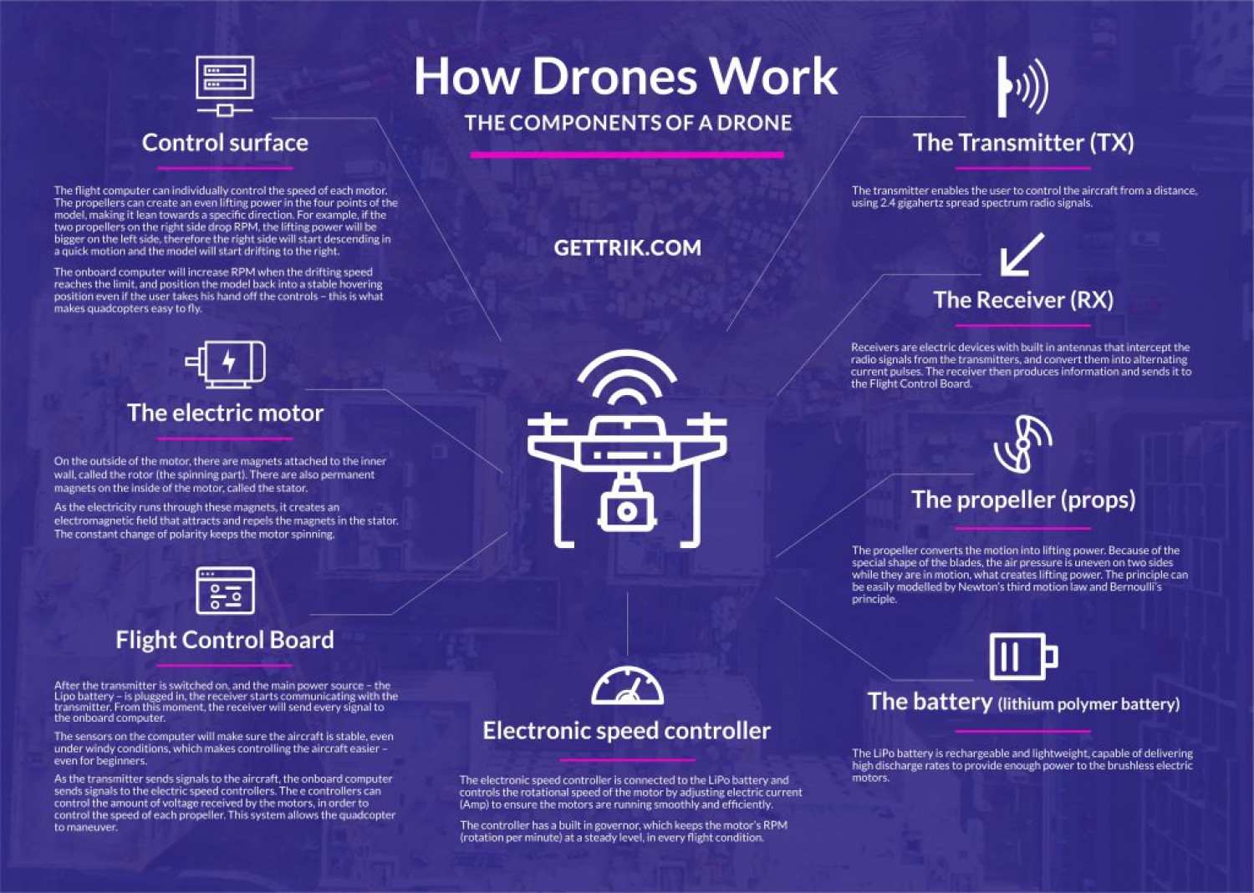
How do drones work?
Drones have two basic functions:
flight mode
navigation
To fly, drones must have a power source, such as battery or fuel. They also have rotors, propellers and a frame. The frame of a drone is typically made of a lightweight, composite material to reduce weight and increase manoeuvrability.
Drones require a controller, which lets the operator use remote controls to launch, navigate and land the aircraft. Controllers communicate with the drone using radio waves, such as Wi-Fi.

Slide 4
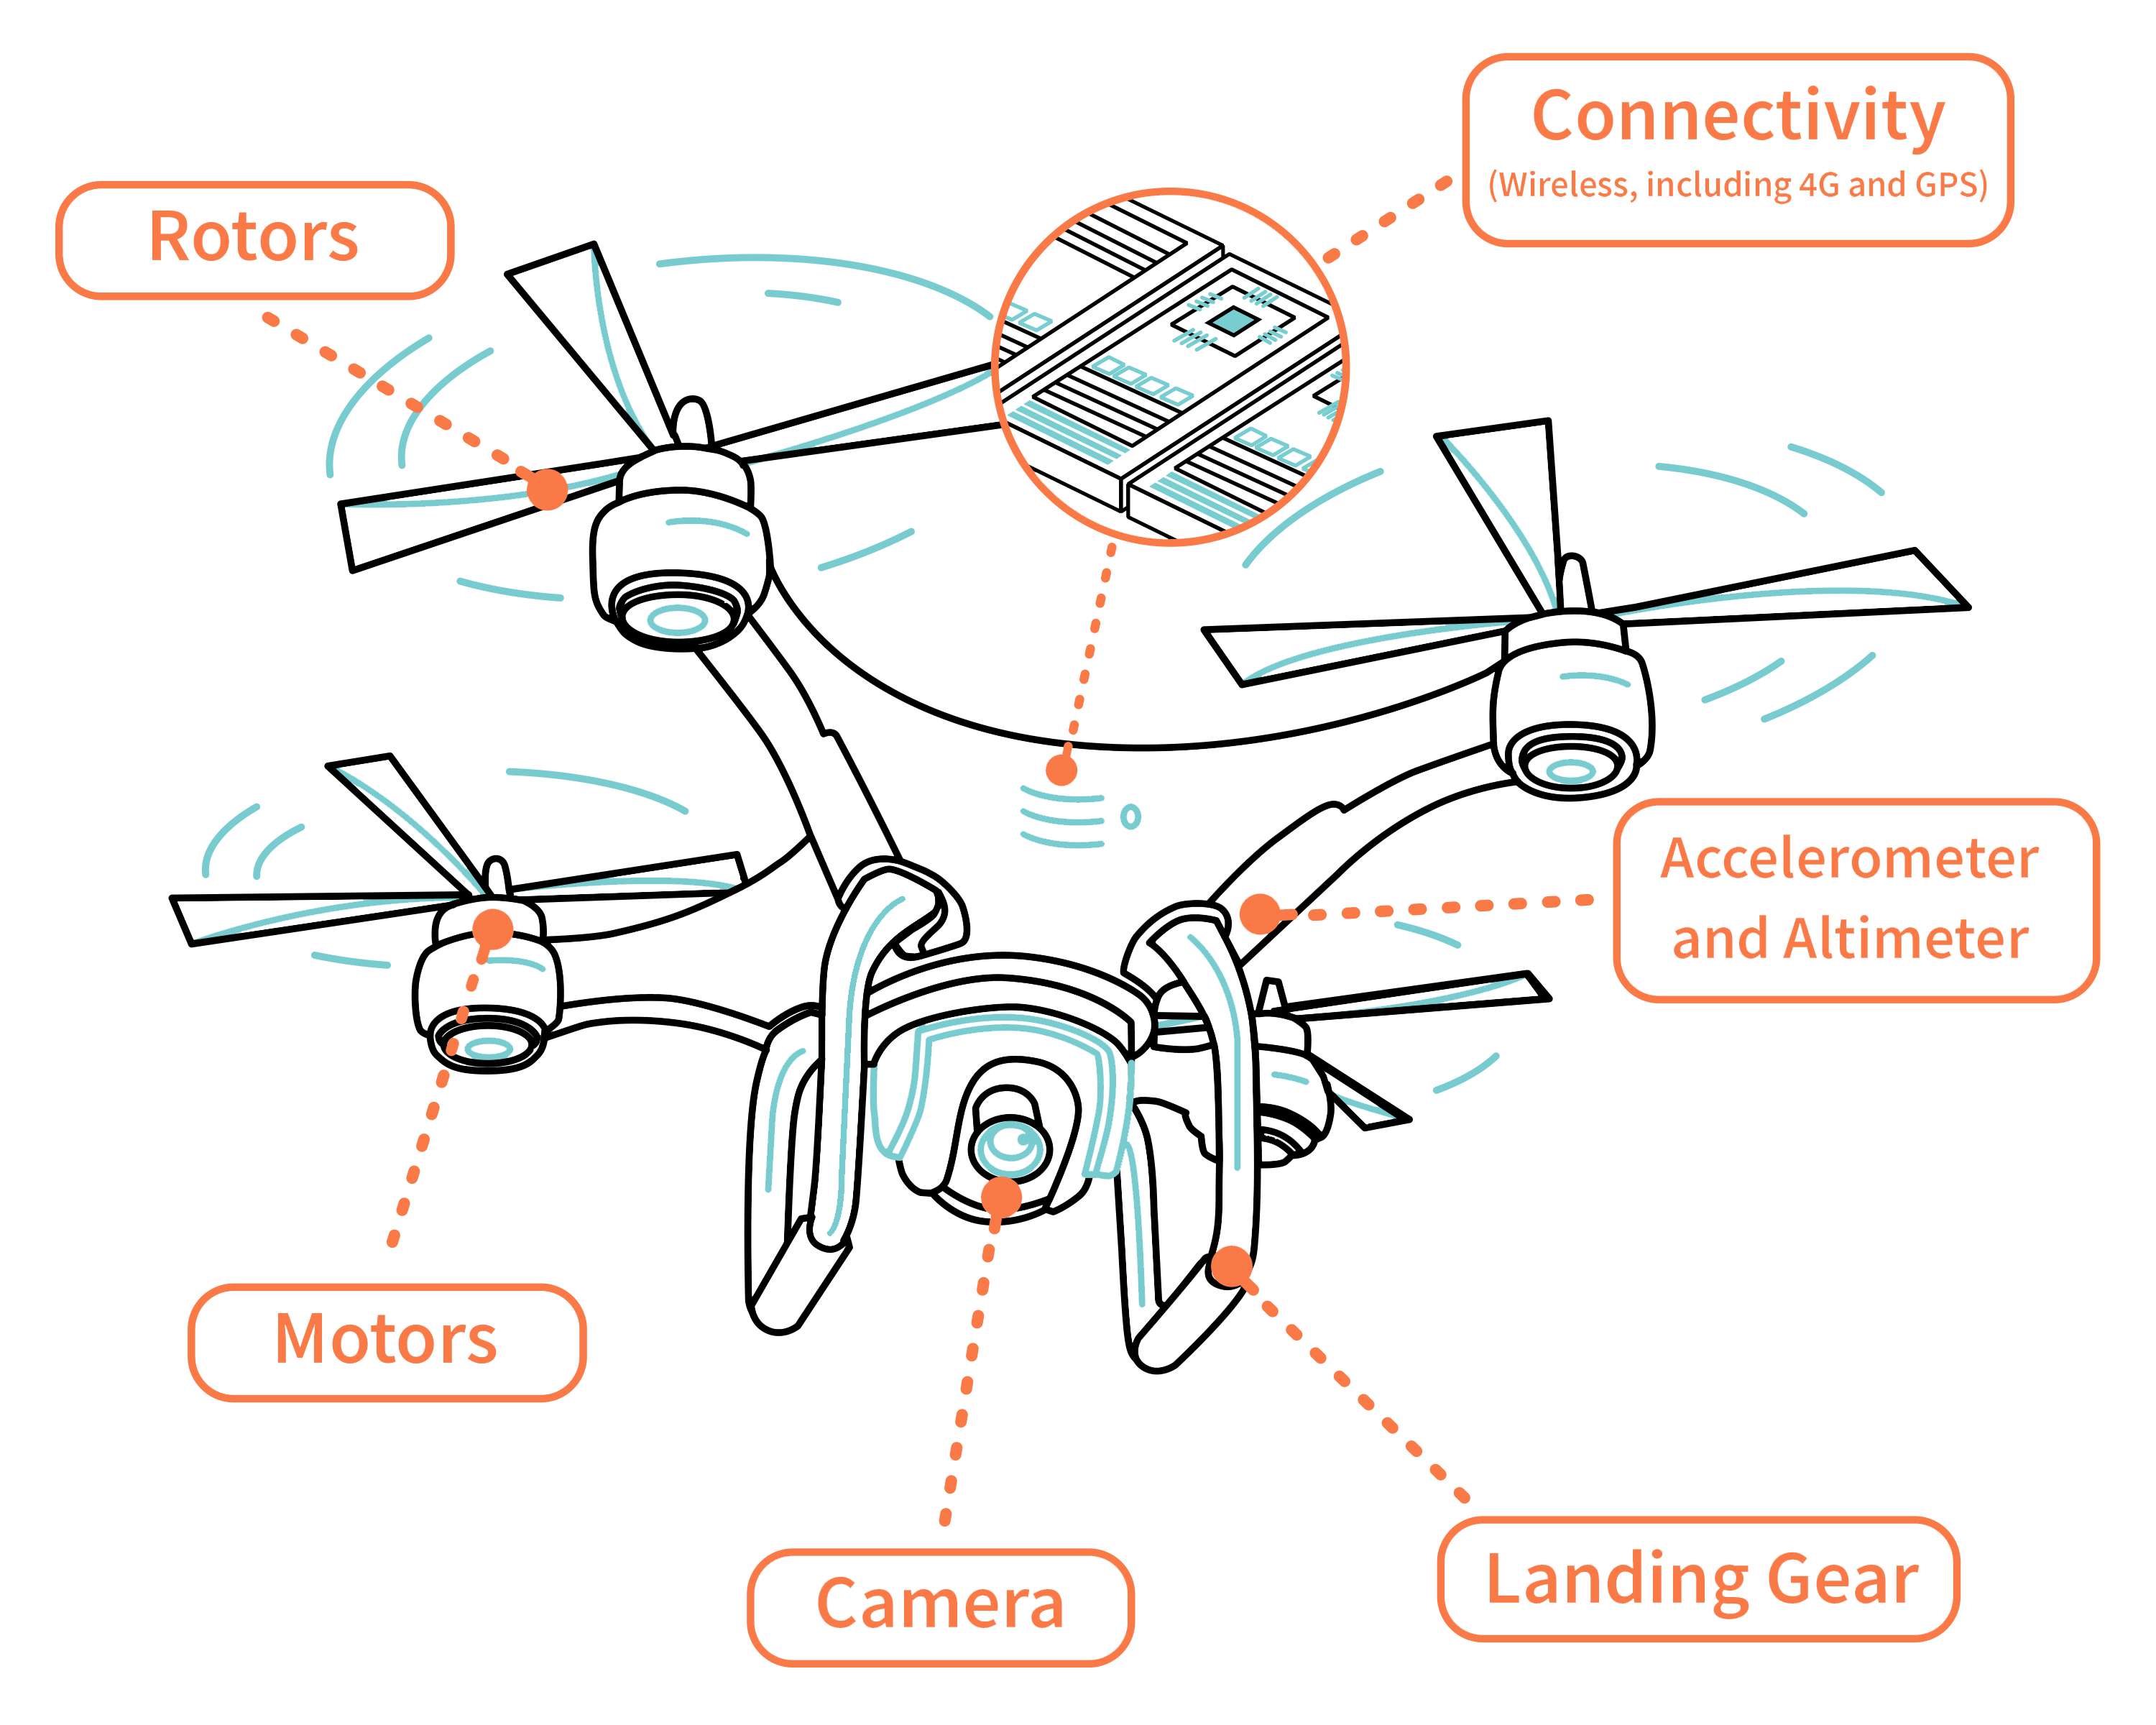
What are common drone features and components?
Drones have a large number of components, including:
electronic speed controllers, which control a motor's speed and direction flight controller
GPS module
Battery
Antenna
Receiver
Cameras
sensors, including ultrasonic sensors and collision avoidance sensors
accelerometer, which measures speed and
altimeter, which measures altitude.

Slide 5
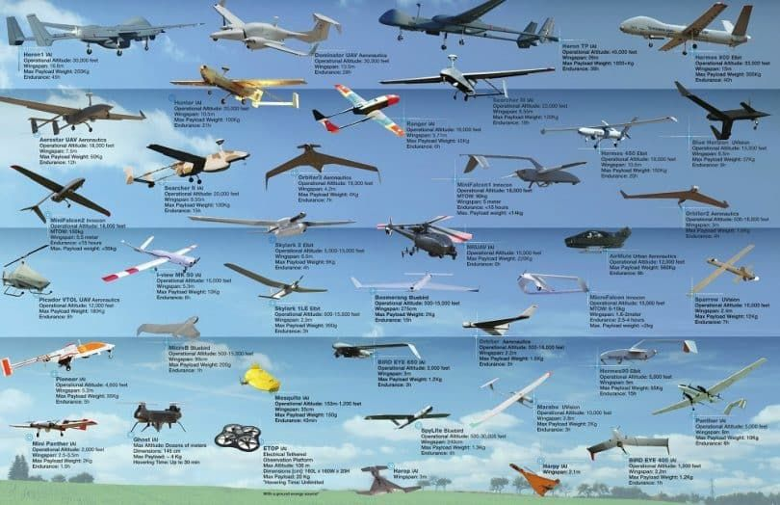
What types of drones are available?
There are two main types of drone platforms:
rotor, including single-rotor and multi-rotor, such as tri-copters, quadcopters, hex-copters and octocopters
fixed-wing, which include the hybrid vertical take-off and landing (VTOL) drones that don't require runways.
Nonmilitary drones are generally either personal and hobbyist ones or commercial aircraft.

Slide 6
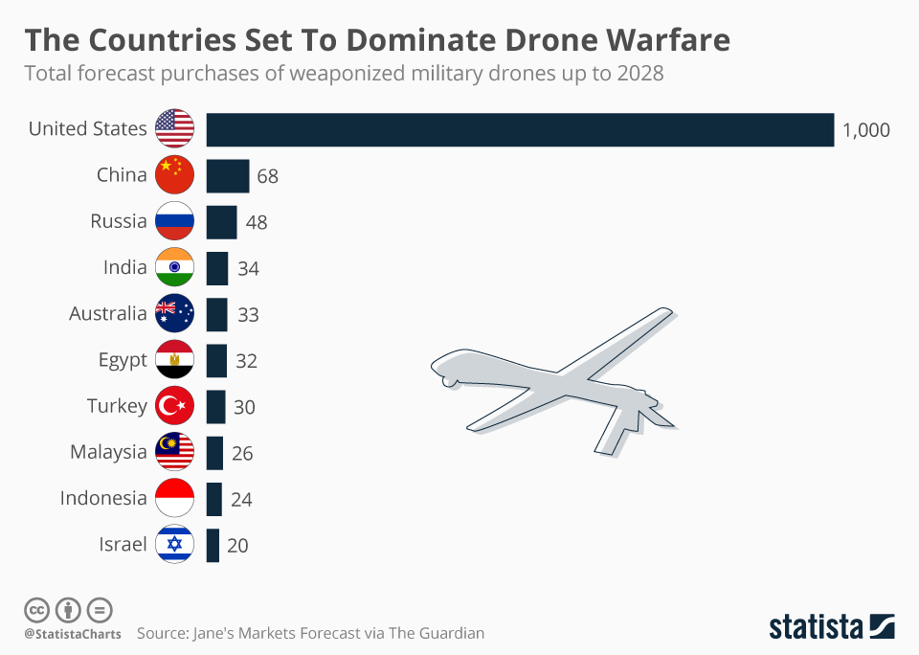
Military drones stats
Top Sellers
United States
Israel
China are the biggest producers and sellers of drones.
America’s leading combat drone is the MQ-9 Reaper
Top Buyers
India
United Kingdom
Indian Navy has leased two MQ-9B SeaGuardian drones from the US. The proposed induction of the MQ-9Bs would give India the distinction of being the only non-NATO country to receive these combat drones from the US

Slide 7
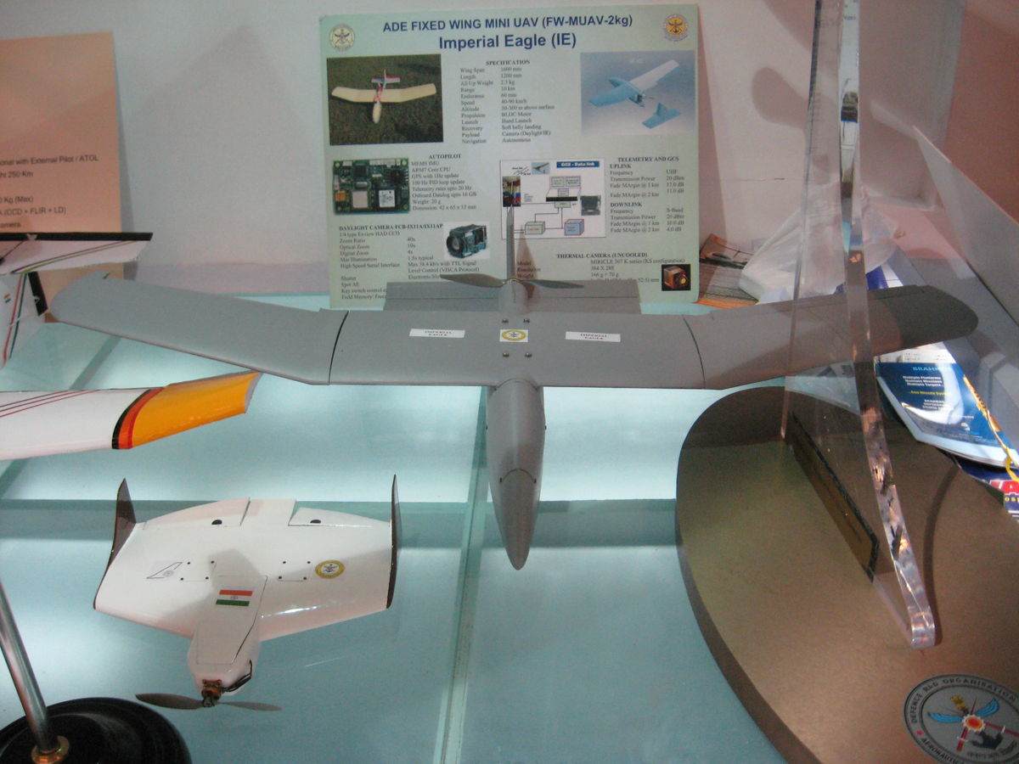
Military drones in action
Bayraktar TB2 unmanned combat aerial vehicle helped Ukrainians in their fight is the Bayraktar TB2 unmanned combat aerial vehicle - a Turkish-made drone that can carry small anti-armor weapons.
The Imperial Eagle is an Indian light-weight mini-UAV developed by the Aeronautical Development Establishment, National Aerospace Laboratories and supported by private vendors. Its primary users are the National Security Guard(NSG) and the military services

Slide 8
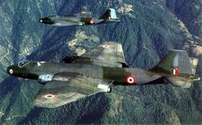
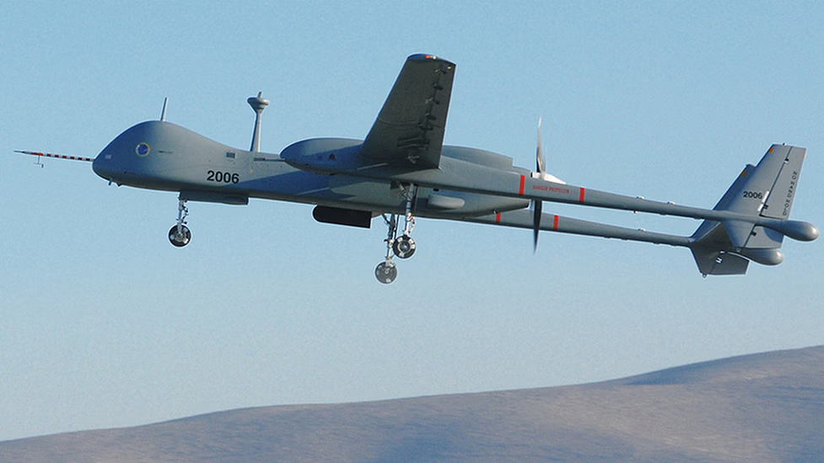
Looking Back: Drones In India
The Indian Army was the first to acquire unmanned aerial vehicles or UAVs in the late 1990s from Israel, and the Indian Air Force and Navy followed suit.
India first used military drones during the 1999 Kargil war with Pakistan. At first, the Indian Air Force deployed manned English aircraft for photo reconnaissance along the Line of Control, but this system proved highly inefficient and strategically weak over the mountainous Kargil terrain.
After India lost a Canberra PR57 to Pakistani infrared homing missiles, Israel discreetly supplied the Indian Air Force with the IAI Heron and Searcher drones, which were useful for acquiring target information along the Line of Control.
Since Kargil, India has procured numerous Israeli military unmanned aircraft. In 2009, the Indian Air Force purchased 10 Harops in a $100 million contract with Israel Aerospace Industries.
In 2013, the Indian Air Force made a $280 million deal with Israel Aerospace Industries for a new series of Heron medium-altitude, long-endurance drones.

